Slide 1
Geodatabase Design and Management
Georeferencing & Editing

Slide 2
For Any Project, Managing Data is Key
What stakeholders do you have to work with?
What are their short term and long term needs?
What data can you collect now to prevent going back to redoing the data collection

Slide 3
For Any Project, Managing Data is Key
For your thoughts
Think about what data you need to collect
Do you want a user to manually enter the data or do you want coded values (Domains)?
Will help in painting a clean dataset
How many characters are needed for manually entered data?

Slide 4
11 Steps to Designing Geodatabases
Identify the information products you will create and manage with your GIS
Identify the key data themes based on your information requirements
Specific the scale ranges and the spatial representation of each data theme at each scale
Decompose each representation into one or more geographic datums

Slide 5
11 Steps to Designing Geodatabases
Define the tabular databases structure and behavior for descriptive attributes
Define the spatial behavior, spatial relationships, and integrity rules for your dataset
Propose a geodatabase design
Design editing workflows and map display properties
Assign responsibilities for building and maintaining each data layer

Slide 6
11 Steps to Designing Geodatabases
Build a working prototype. Review and refine your design
Document your geodatabase design

Slide 7
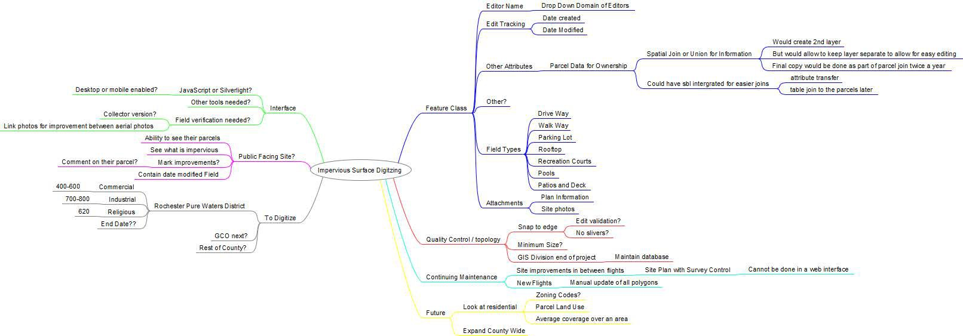

Slide 8
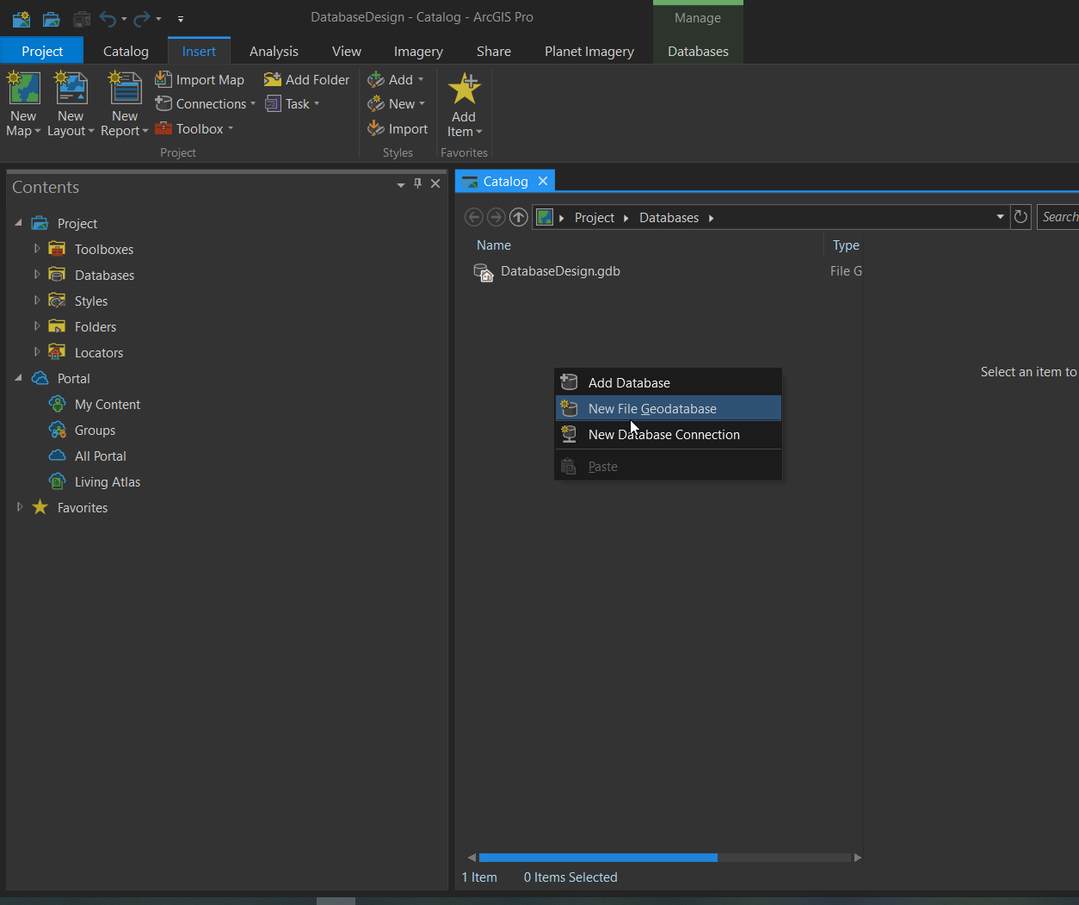
Steps to Create A Geodatabase
Real Easy
Right Click New -> File Geodatabase
Give it a Name

Slide 9
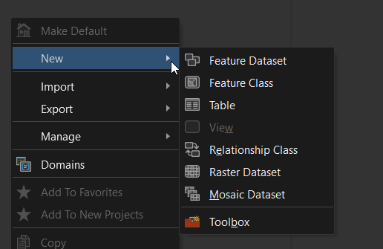
Creating A Feature Class
Inside the File Geodatabase (or Feature Dataset) right click or file new, then Feature Class

Slide 10
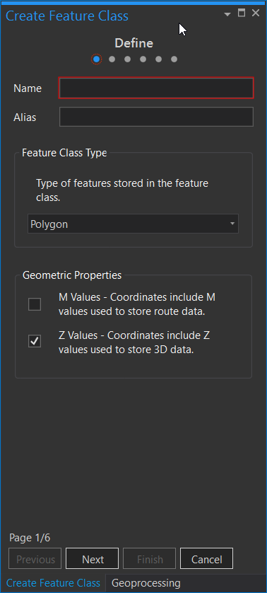
Creating A Feature Class
Inside the File Geodatabase (or Feature Dataset) right click or file new, then Feature Class
Enter a Name and Alias
Alias can have spaces and actual name, name is how to save the data in your geodatabase
Pick you feature type
Point, Line, or Polygon

Slide 11
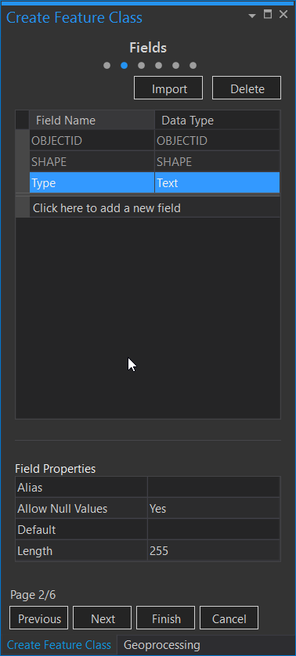
Creating A Feature Class
Define your attributes
For the example in class you will create a type text field
Once we get this part click next and then define the projection

Slide 12
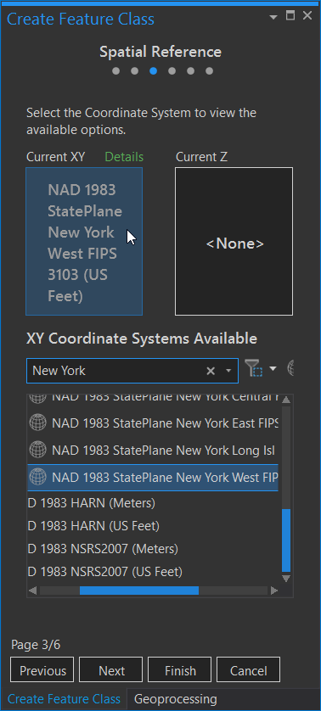
Creating A Feature Class
Define your attributes
For the example in class you will create a type text field
Once we get this part click next and then define the projection
We will use State Plane NAD 1983 New York West (US Feet)
Click Next Through the different screens

Slide 13
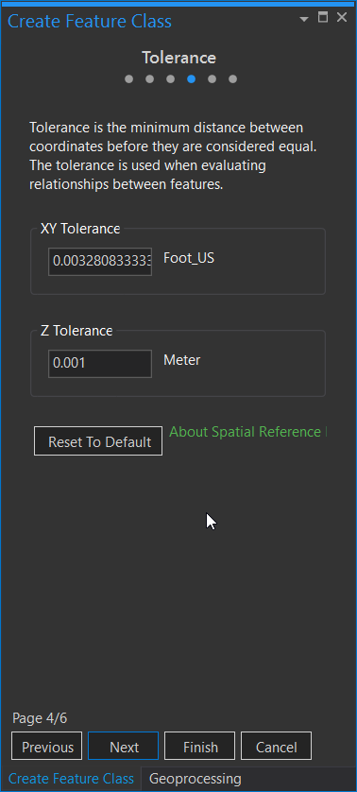
Creating A Feature Class
Define your attributes
For the example in class you will create a type text field
Once we get this part click next and then define the projection
We will use State Plane NAD 1983 New York West (US Feet)
Click Next Through the different screens

Slide 14
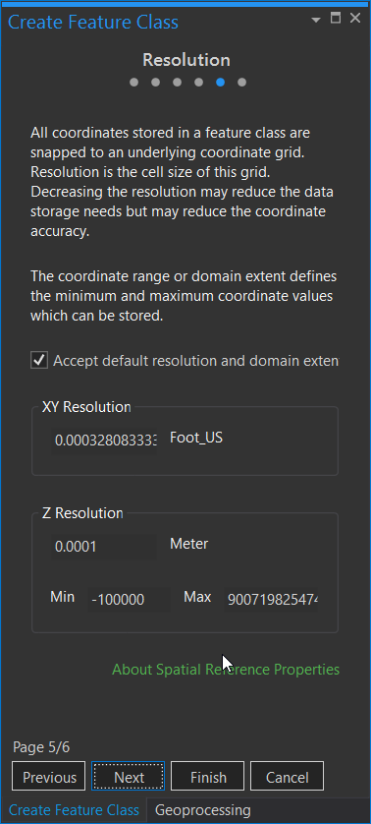
Creating A Feature Class
Define your attributes
For the example in class you will create a type text field
Once we get this part click next and then define the projection
We will use State Plane NAD 1983 New York West (US Feet)
Click Next Through the different screens

Slide 15
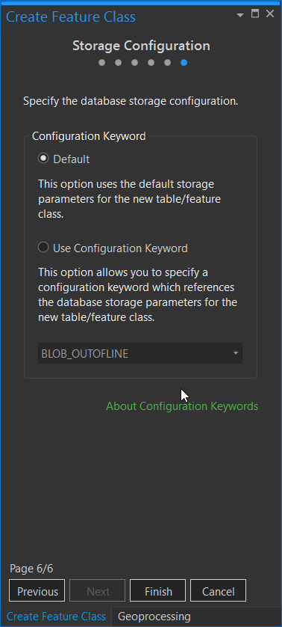
Creating A Feature Class
Define your attributes
For the example in class you will create a type text field
Once we get this part click next and then define the projection
We will use State Plane NAD 1983 New York West (US Feet)
Click Next Through the different screens

Slide 16
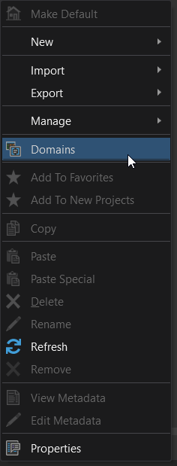
Building A Domain
Domains allow you to standardize the data
Right click in the database and Click Domains

Slide 17
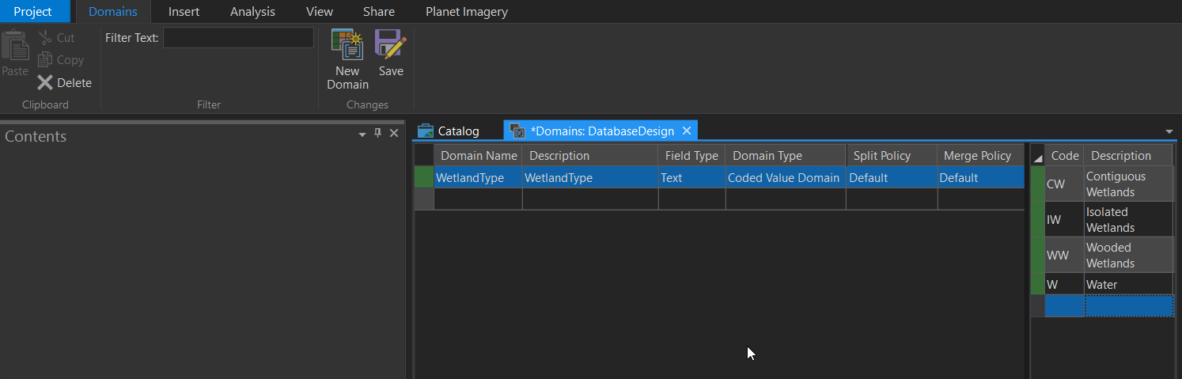
Building A Domain
Domains allow you to standardize the data
Right click in the database and Click Domains
Use the Domain View and Add a New Domain for Wetland Type (Make Sure to Save when you are done)

Slide 18
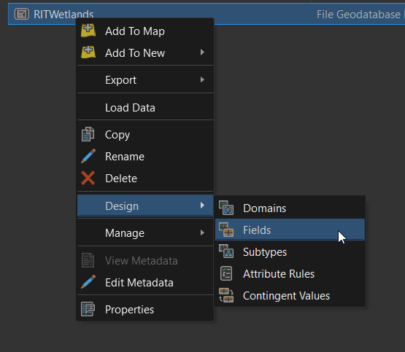
Adding the Domain to Our Data
Right Click on our Layer
Go to Design then Fields

Slide 19
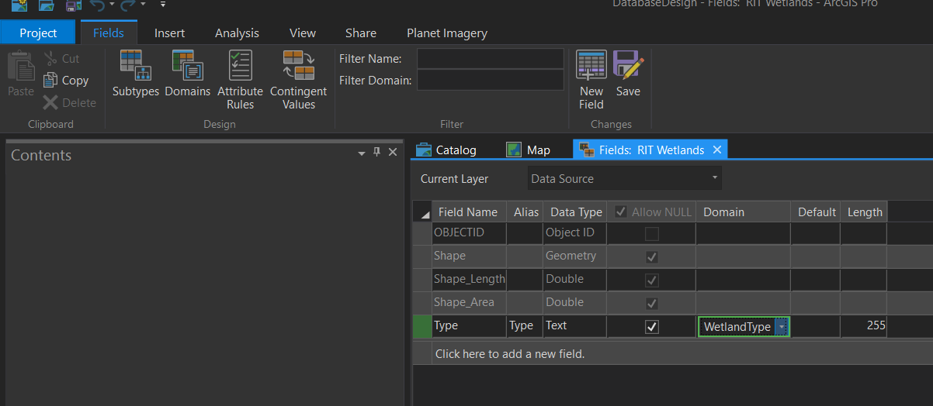
Adding the Domain to Our Data
Right Click on our Layer
Go to Design then Fields
Click on Domain and then Select the Wetland Type
Click Save To Save the Changes

Slide 20
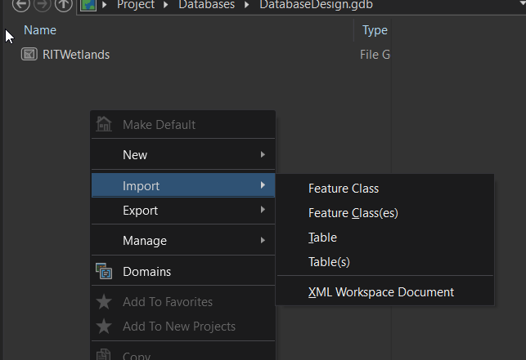
Importing Data Into Your Geodatabase
Simple Import and Export Commands to move your data around

Slide 21
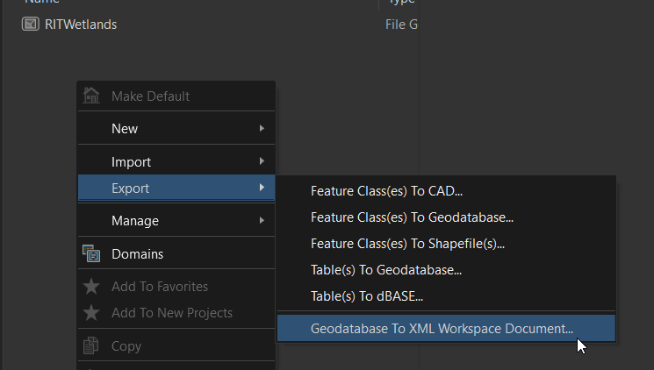
Exporting Data Into Your Geodatabase
Simple Import and Export Commands to move your data around
Can create CAD, Shapefiles, and move to geodatabases
You will also notice an XML Workspace Document
This is a way to work with the database schema outside of ArcGIS

Slide 22
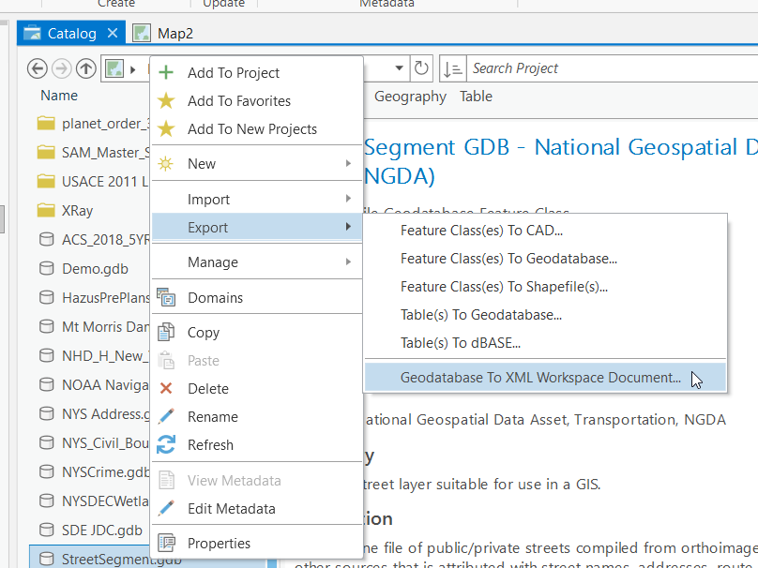
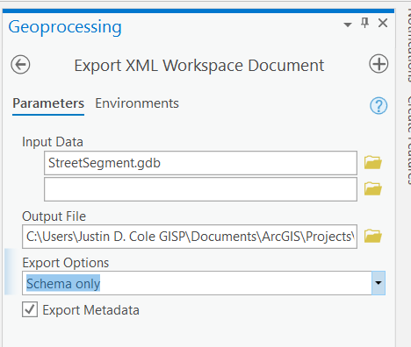
Exporting your geodatabase Schema to XML
If you want to share the geodatabase schema that you just created you can create an XML Workspace
Using the XML a user can reconstruct the schema and even the geodatabase with just one step
To create the XML Workspace right click on your geodatabase
Then export Geodatabase to XML Workspace Document
Your Input will be the geodatabase
Save the output to somewhere you know and with a good name
Then set it to Schema only
Data will export all of the data along with the schema

Slide 23
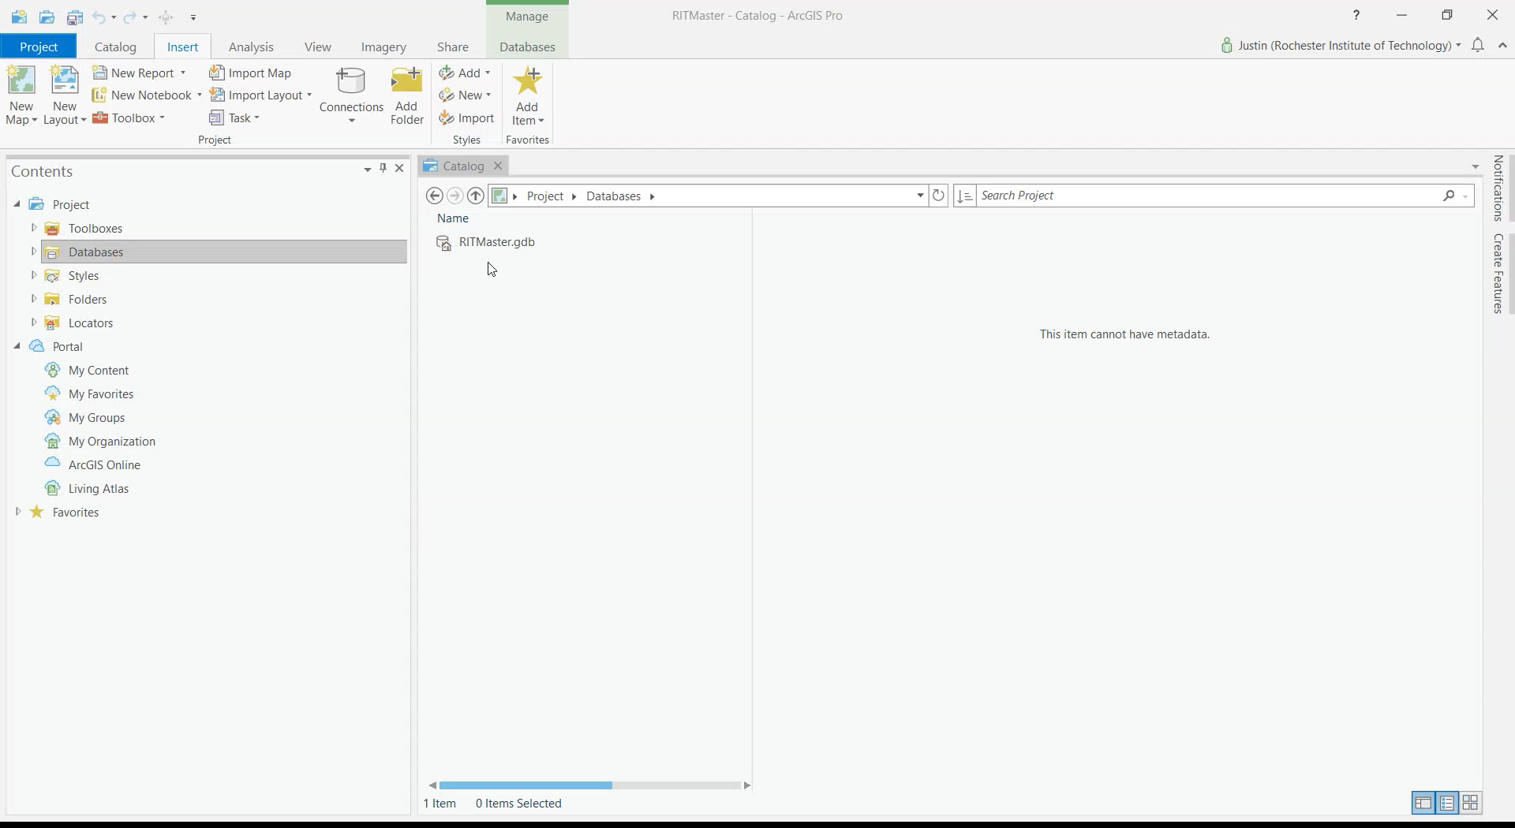

Slide 24
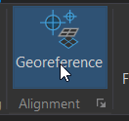

Georeferencing
Georeferencing is using an unprojected image and using known landmarks in a GIS placing that image in its projected space
It is done through the Georeferencing Ribbon (found in the Imagery Ribbon)
You can use the toolbar to roughly fit the drawing to the space
You can use the add control points to help line up the data

Slide 25
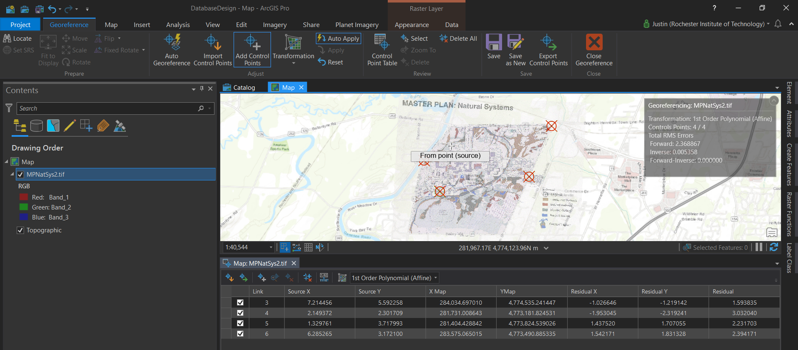
Georeferencing
One thing to always know, when adding control points always go from the image to the map to line up your data
You can use the Link Table to see your error
For this example, your error should be very close to zero
Many times your scanned image is not going to be as clean so you will need to get as low as possible, but about half the resolution is recommended
When you finish (more than 4 points) Click Save in the Georefrecing Ribbon and that will save the data to the image

Slide 26

Editing
To create data you will need to use the Edit Ribbon
This can be found like any other toolbar or in the main menu as the pencil with some dots and lines
To edit you need layers to edit (the vector data you are working on)
The editor will activate when you specify the start editing command
Anything you do in an edit session will be temporary until you save your edits

Slide 27
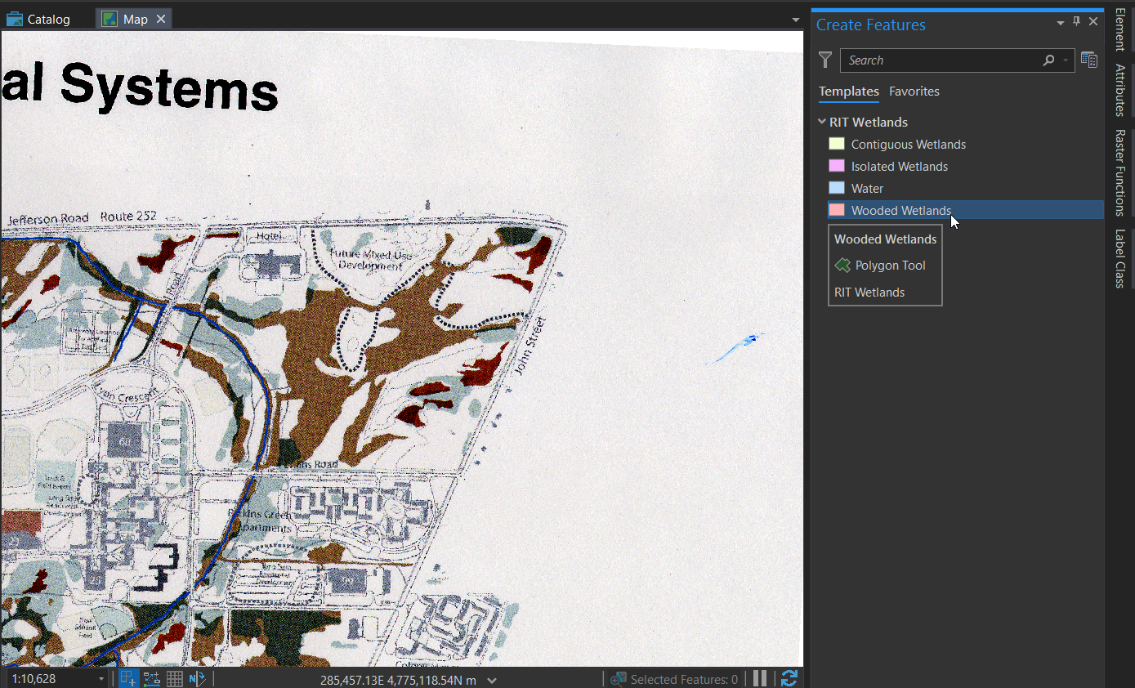
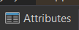
Editing
If you have your symboloy set before you start editing it will add it to your feature template
To add a new feature, click on the one you want to add and then draw it on the map
To finish a line feature you can either double click or hit f2
Once you have a feature you can click on the attribute button and type in the attributes into the table

Slide 28
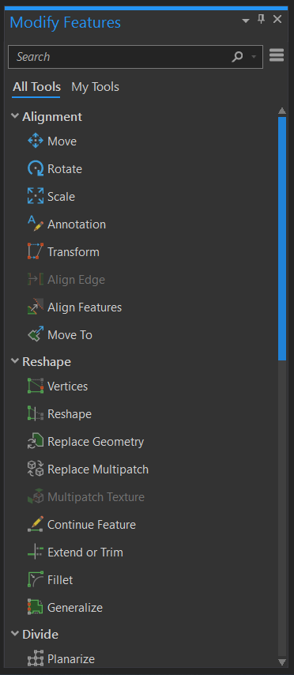
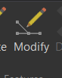
Editing
To edit an existing feature, you can use the modify tool
Just single click to edit the attributes or double click to edit the geometry
Once you are done you will start to see your features appear on your map document

Slide 29
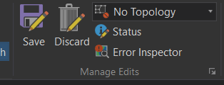
Save Edits
Make Sure to Save Your Edits

Slide 30
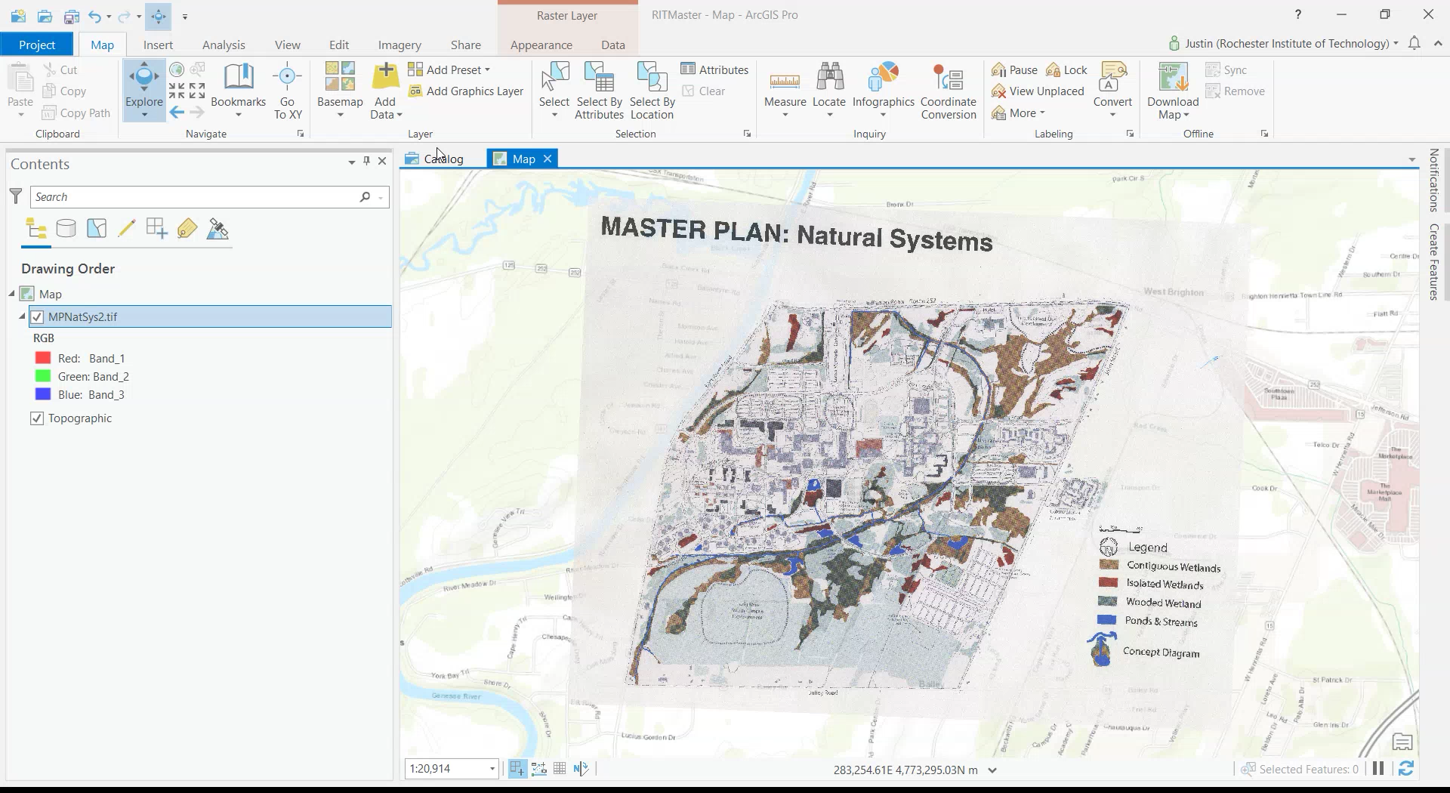

Slide 31
Data Creation Lab
This lab is 2 parts
Part 1 is a database creation and data management assignment. You will be making a GIS Layer for the Old RIT Masterplan (MPNatSys2.tif). To do this you will need to have a geodtabase setup with the required 3 feature classes (Wetlands, Buildings, and 1 layer of your choice) each with attributes, domains, and anything else needed. Your deliverable for this part will be the XML database schema and a brief writeup on your reasoning how you setup your third layer. Also in the writeup explain if there is enough information in the scan to populate the all of the layers in the database and if not where would you go to get it. Due November 4th
Part 2 is adding data to your geodatabase. You will have to digitize the wetlands, buildings, and the third layer of your choice with the attributes and domains you selected in part 1. Your deliverable for this part will be the project file (ppkx). Due November 18th

Slide 32
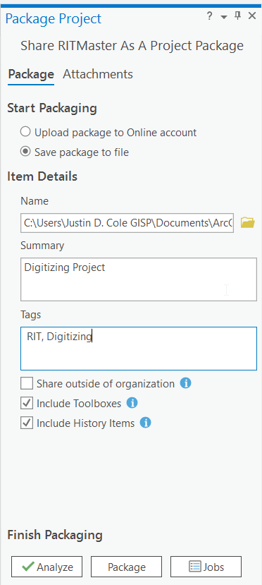
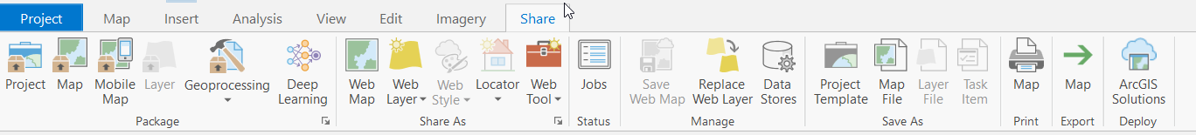
Reminder How to Create the Project Package PPKX
Go to the share ribbon and then Project
Save the Package to file
Save the file
Give it a Summary and Tag
Then Package

